Slide 1

STRANDBEEST: COAL MINE ROBOT FOR DETECTION OF HAZARDOUS GAS AND OBJECTS
Department of Electronics and Communication Engineering
Under the Guidance of
Prof. V. Rajya Lakshmi
Head Academics
ANITS
Presented By :
S. Prabhas Akhil Reddy(A21126512112)
B. Suvarna(A21126512068)
G. Uday Rahul (A21126512080)
D.V. Sai Ramesh(A21126512076)

Slide 2
ABSTRACT
Coal mines are prone to dangerous accidents caused by the presence of harmful gases such as Methane (CH4), Carbon Monoxide (CO), and Carbon Dioxide (CO2). These gases, when present in high concentrations, can lead to suffocation and affect the human respiratory system. In past years, such incidents have led to numerous fatalities, highlighting the need for enhanced safety measures in mining environments. Traditional robots for gas detection face limitations in navigating rough and uneven terrain, such as rocky or sandy surfaces found in coal mines. This significantly reduces their utility and effectiveness. The primary objective of this project is to design and develop a Strandbeest-inspired robot capable of operating on diverse surfaces, including rocky and sandy terrains, to detect and monitor harmful gases (CH4, CO, CO2) in real-time. Additionally, the robot will be equipped with object detection capabilities to ensure safety by avoiding obstacles and enhancing the protection of miners working in the mine.

Slide 3
METHODOLOGY
1.Theo-Jansen Linkage Mechanism:
The robot uses a Theo-Jansen linkage to mimic the motion of crab legs and human limbs, enabling efficient movement on uneven surfaces like rocks and sand.
2.Flexibility and Ground Adaptation:
The mechanism ensures the robot can move across diverse terrains with stability and flexibility, adapting to harsh environments such as coal mines.
3.Robot Components:
Gear Motors for movement, ATMEGA 328P Microcontroller for control, Bluetooth Module for wireless communication, and MQ9 Gas Sensors for detecting harmful gases like Methane and Carbon Monoxide.
4.Object Detection and Safety:
The robot uses IR Sensors and a Camera Module to detect obstacles and avoid collisions, sending real-time alerts to operators for improved safety.

Slide 4
UNIQUENESS AND DISTINCTIVE FEATURES OF THE PROJECT IDEA
The uniqueness and distinctive feature of using a Strandbeest robot for object detection in a coal mine lies in its ability to combine advanced robotics with object detection technology to create a versatile and efficient monitoring system. This project stands out due to the following key features:
Autonomous Operation: The Strandbeest robot can operate autonomously, navigating through the coal mine environment without constant human intervention, which sets it apart from traditional monitoring methods.
Customization: These robots can be customized with various sensors and technologies to suit the specific needs of object detection in a coal mine, making them adaptable to different environments and detection requirements.

Slide 5
Continuous Monitoring: The Strandbeest robot offers continuous monitoring capabilities, allowing for real-time detection of objects in the mine environment, which enhances safety and improves overall monitoring efficiency.
Cost-Effectiveness: Compared to traditional monitoring methods, using a Strandbeest robot for object detection can be more cost-effective in the long run due to lower operational costs and reduced risks to human workers.
Safety Enhancement: By deploying robots for object detection, the safety of mine workers is significantly improved as they can avoid potentially hazardous areas, reducing the risk of accidents and injuries.

Slide 6
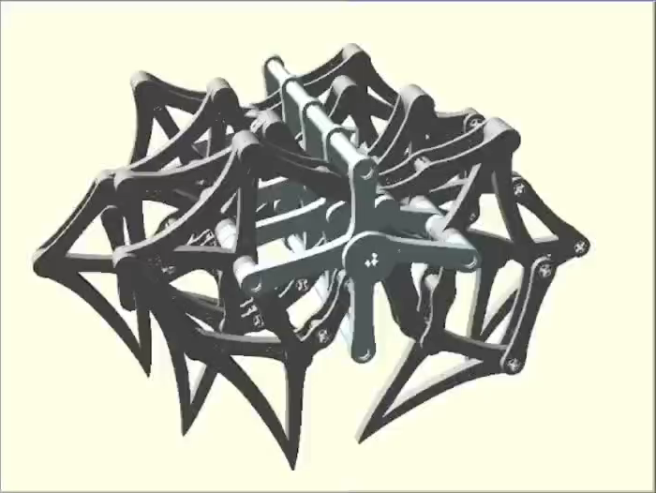
DEMONSTRATION
Working of Theo-Jansen linkages:
It is an eleven bar mechanism designed by ‘Theo-Jansen’ in his collection Strandbeest
Theo Jansen linkages convert rotary motion into a walking leg movement using interconnected rods.
As the crank rotates, it drives the leg in a smooth, natural walking path.
This mechanisam allows stable ,efficient motion without electronics or wheels.

Slide 7
EXPECTED RESULTS / OUTCOMES
Enhanced Safety: Robots can operate in hazardous environments, reducing the risk to human workers. They can navigate through dangerous areas, such as those with toxic gases, unstable roofs, or after explosions, to conduct inspections and ensure safety.
Accurate Data Collection: Equipped with sensors and cameras, these robots can gather detailed information on mine conditions. This includes monitoring gas levels, structural integrity, and temperature, providing real-time data that can prevent accidents.
The final outcome is the working of strandbeest robot that detects and monitors the harmful gases and also objects that come across the robot.
This robot can also be used in the terrestrial areas ,to check whether the place is suitable for the people or not by collecting the necessary data like gases and objects.

Slide 8
SOCIAL ISSUES (IF ANY) WHICH CAN BE RESOLVED BY THE PROJECT IDEA
Worker Safety: By taking on dangerous tasks, such as inspecting unstable areas or handling hazardous materials, the robot can significantly reduce the risk of accidents and fatalities among miners.
Health Risks: The robot can help mitigate long-term health risks, like respiratory diseases caused by coal dust, by reducing miners' exposure to harmful environments.
Environmental Monitoring: The robot can be equipped with sensors to monitor environmental conditions, such as air quality and gas levels, helping to prevent environmental degradation and ensuring safer working conditions.
Economic Stability: By preventing accidents and improving overall safety, the robot can help maintain steady production levels and economic stability in mining communities.
Community Health and Well-being: Reducing accidents and health risks in mines can lead to improved overall community health and well-being, as fewer families will suffer the consequences of mining-related injuries and diseases.

Slide 9
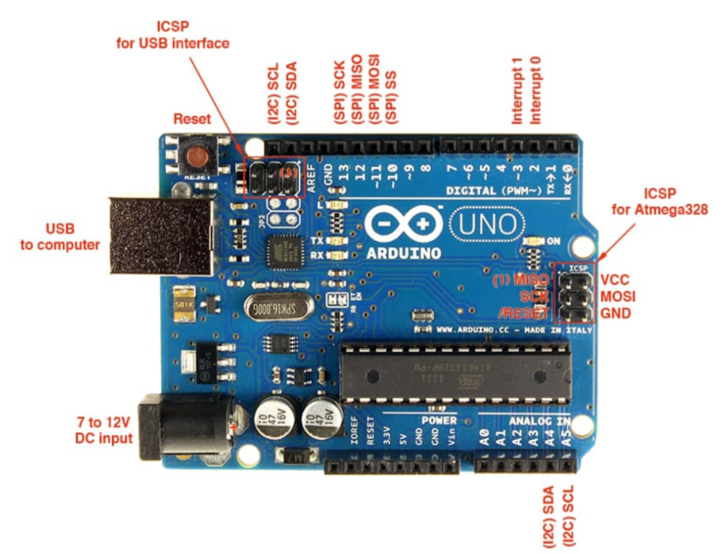
TOOLS/COMPONENTS
Arduino Uno
IR Sensors
Gas sensor module
Bluetooth Module
Motor Driver
Power Supply
Nuts and Bolts
DC Gear Motors
Acrylic Sheets
Arduino IDE Software

Slide 10
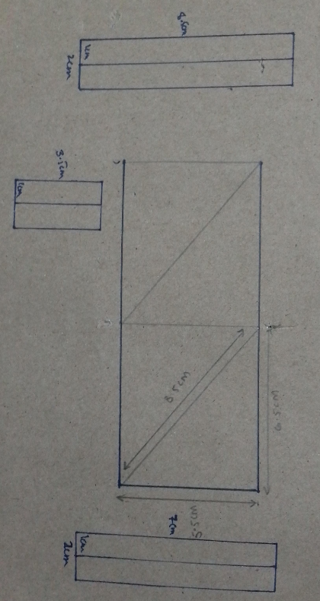
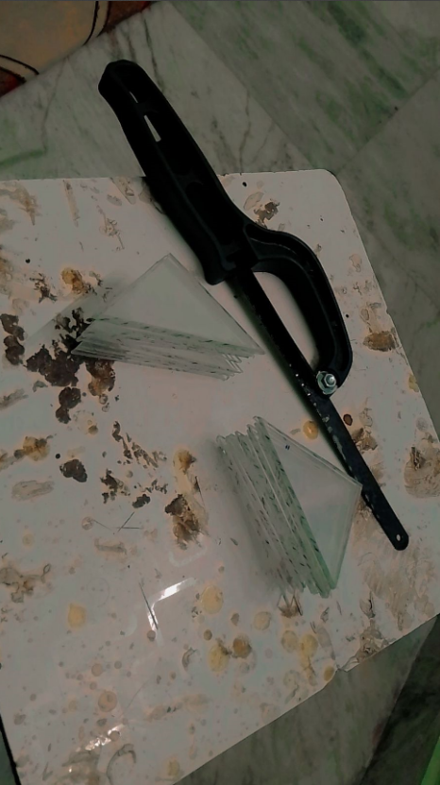
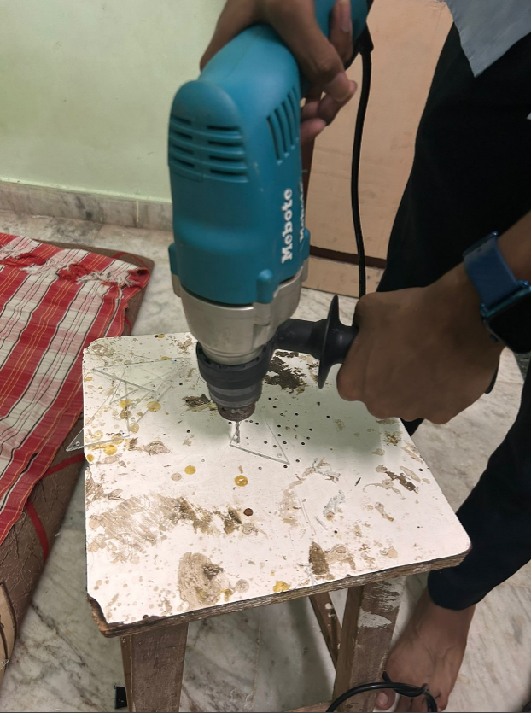
PROTOTYPE CONSTRUCTION PROCESS
The major tasks for building the prototype of the Strandbeest robot such as material selecting, marking, cutting, drilling and organizing, were completed till now.

Slide 11
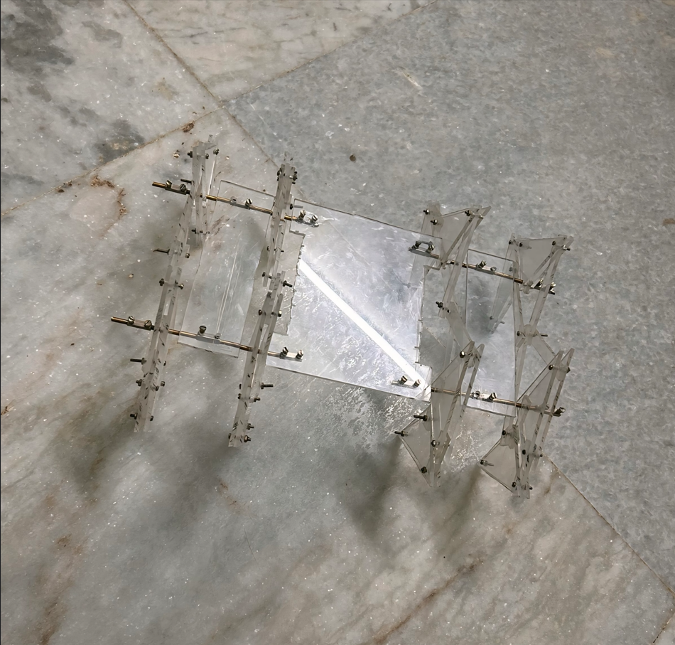
PROTOTYPE OF STRANDBEEST ROBOT
Fan connectors
Acrylic sheets
Welding Rods (3mm)
Nuts and Bolts (3mm)

Slide 12
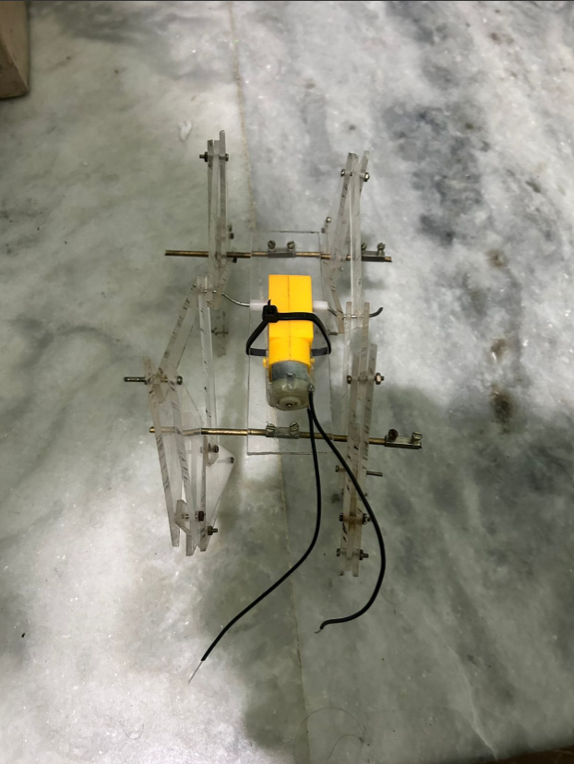
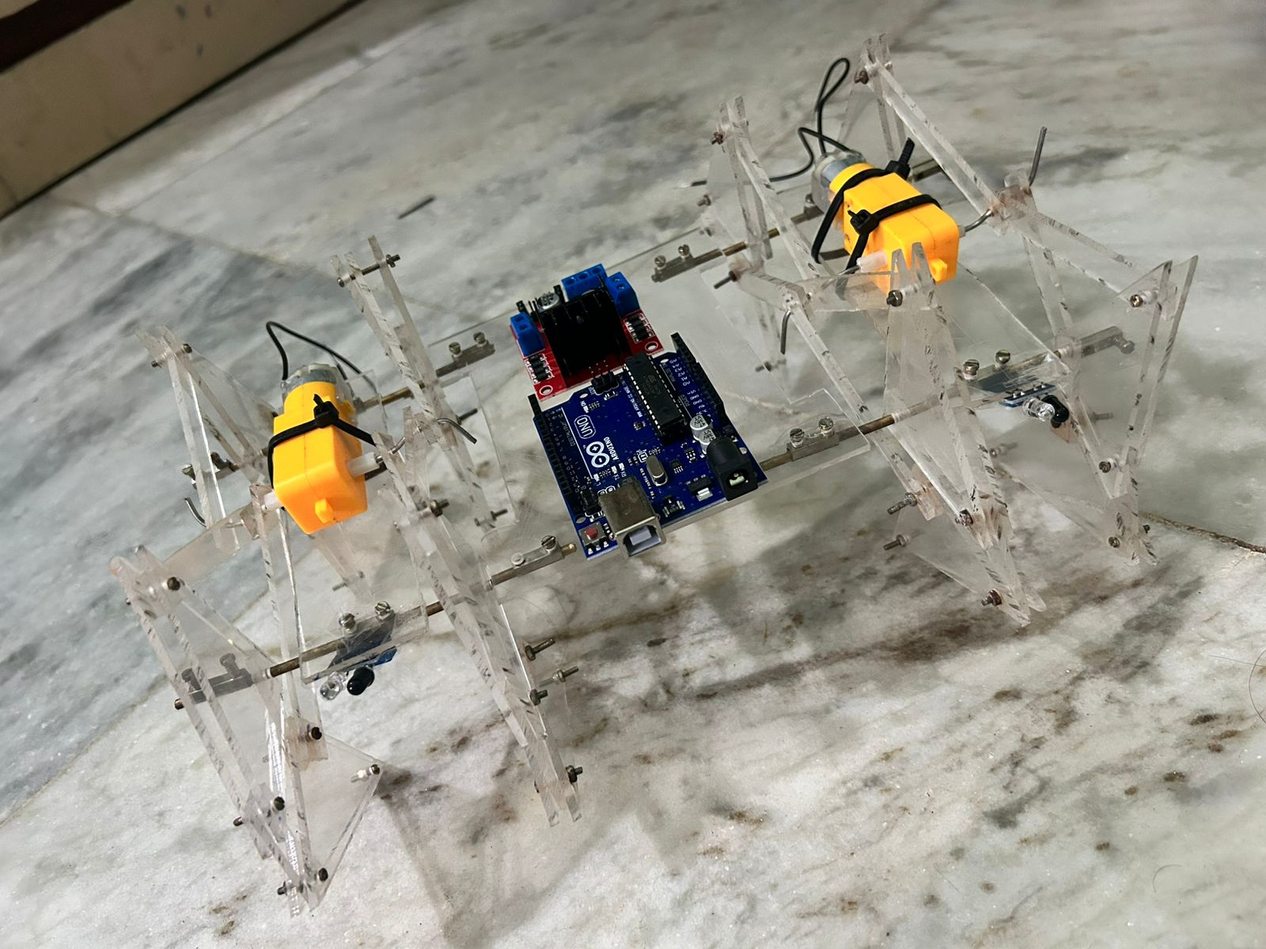
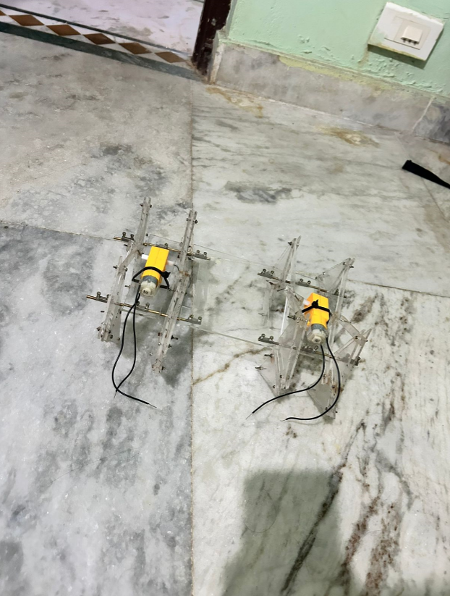
INTERFACING OF STRANDBEEST ROBOT
Dual Shaft DC Motor
L298N Motor Driver
Arduino UNO R3 ATmega328P
IR Sensor

Slide 13
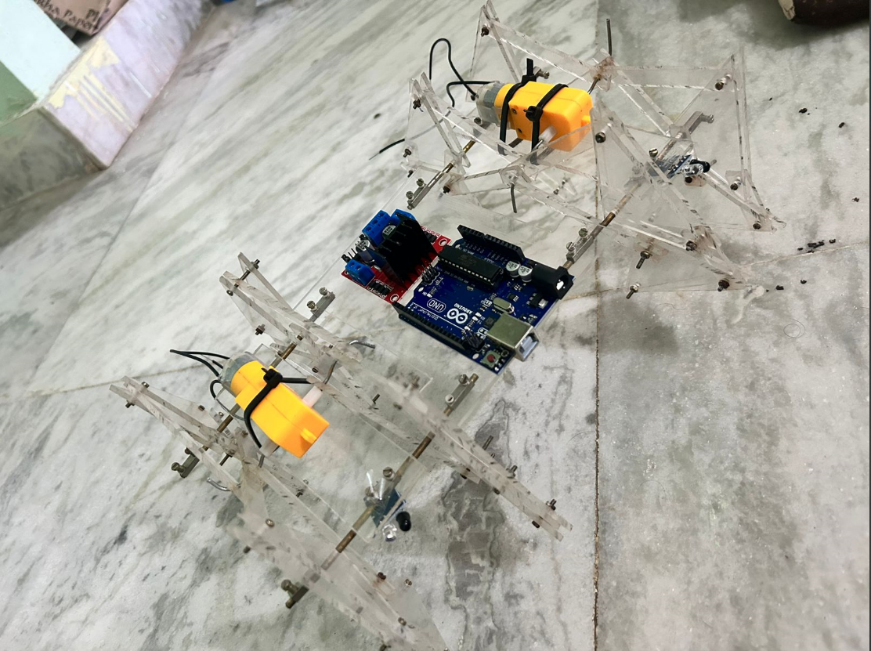
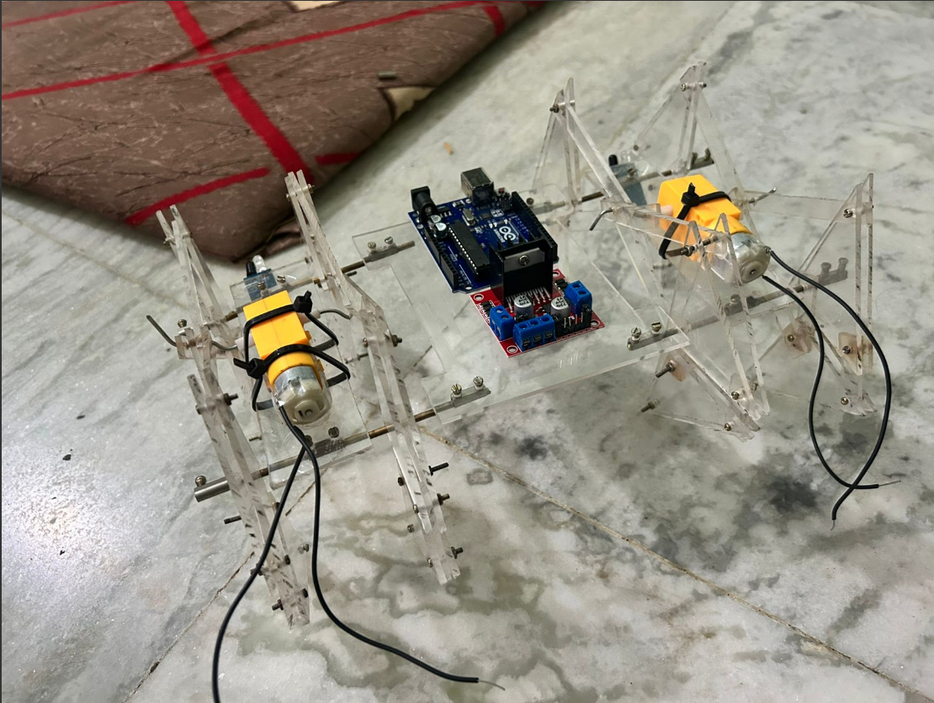
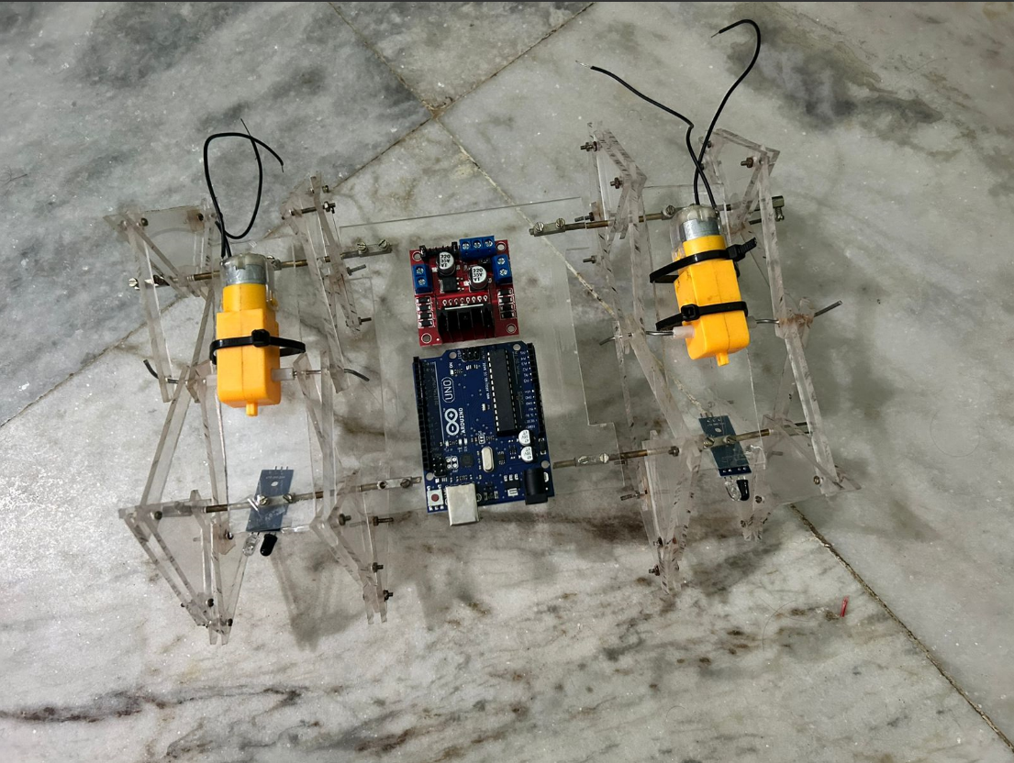
VISUAL REPRESENTATION OF THE ROBOT
Side View
Front View
Top View

Slide 14
ARDUINO CODE FOR MOVEMENT OF PROTOTYPE
#include<SoftwareSerial.h>
#define IN1 13
#define IN2 12
#define IN3 8
#define IN4 7
SoftwareSerial bt(0, 1); // RX, TX
char data;
void setup() {
Serial.begin(9600);
pinMode(IN1, OUTPUT);
pinMode(IN2, OUTPUT);
pinMode(IN3, OUTPUT);
pinMode(IN4, OUTPUT);
digitalWrite(IN1, LOW);
digitalWrite(IN2, LOW);
digitalWrite(IN3, LOW);
digitalWrite(IN4, LOW);
bt.begin(9600);
}
void loop()
{

Slide 15
while (bt.available())
{
{ data = bt.read();
Serial.println(data);}
switch (data)
{
case 'F':
//Serial.println("Forward");
forward();
break;
case 'B':
//Serial.println("Reverse");
reverse();
break;
case 'L':
//Serial.println("Left");
left();
break;
case 'R':
//Serial.println("Right");
right();
break;

Slide 16
}
if (bt.available() < 0)
{
//Serial.println("No Bluetooth Data ");
}
delay(100);
}
void forward() {
digitalWrite(IN1, HIGH);
digitalWrite(IN2, LOW);
digitalWrite(IN3, LOW);
digitalWrite(IN4, HIGH);
delay(20);
}
void reverse() {
digitalWrite(IN1, LOW);
digitalWrite(IN2, HIGH);
digitalWrite(IN3, HIGH);
digitalWrite(IN4, LOW);
delay(20);
}
case 'S':
//Serial.println("Stop");

Slide 17
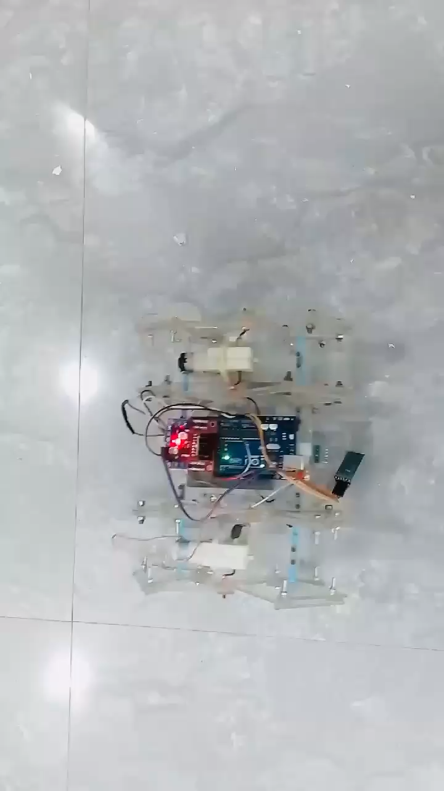
stoprobot();
break;
}
void left() {
digitalWrite(IN1, HIGH);
digitalWrite(IN2, LOW);
digitalWrite(IN3, HIGH);
digitalWrite(IN4, LOW);
delay(20);
}
void right() {
digitalWrite(IN1, LOW);
digitalWrite(IN2, HIGH);
digitalWrite(IN3, LOW);
digitalWrite(IN4, HIGH);
delay(20);
}
void stoprobot() {
digitalWrite(IN1, LOW);
digitalWrite(IN2, LOW);
digitalWrite(IN3, LOW);
digitalWrite(IN4, LOW);
delay(20);
}

Slide 18
ARDUINO CODE FOR OBJECT AND GAS DETECTION
#include<SoftwareSerial.h>
#include <Servo.h>
#define IN1 6
#define IN2 7
#define IN3 8
#define IN4 9
#define TRIG_PIN 10
#define ECHO_PIN 11
#define MQ135_PIN A0
SoftwareSerial bt(0, 1); // RX, TX
Servo scanServo;
char data;
void setup() {
Serial.begin(9600);

Slide 19
bt.begin(9600);
pinMode(IN1, OUTPUT);
pinMode(IN2, OUTPUT);
pinMode(IN3, OUTPUT);
pinMode(IN4, OUTPUT);
pinMode(TRIG_PIN, OUTPUT);
pinMode(ECHO_PIN, INPUT);
scanServo.attach(5);
// attachservo to pin 5 scanServo.write(90);
// center position
digitalWrite(IN1, LOW);
digitalWrite(IN2, LOW);
digitalWrite(IN3, LOW);
digitalWrite(IN4, LOW);
}
void loop() {
if (bt.available()) {
data = bt.read();
Serial.println(data);
switch (data) {
case 'F': forward(); break;
case 'B': reverse(); break;

Slide 20
case 'L': left(); break;
case 'R': right(); break;
case 'S': stoprobot(); break;
case 'U': obstacleScan();
break;
}
}
// Always show MQ135 value
int mq135_value = analogRead(MQ135_PIN);
Serial.print("Air Quality (MQ135): ");
Serial.println(mq135_value);
delay(100);
}
void forward()
{
digitalWrite(IN1, HIGH);
digitalWrite(IN2, LOW);
digitalWrite(IN3, LOW);
digitalWrite(IN4, HIGH);
delay(20);
}

Slide 21
void reverse() {
digitalWrite(IN1, LOW);
digitalWrite(IN2, HIGH);
digitalWrite(IN3, HIGH);
digitalWrite(IN4, LOW); delay(20);
}
void right() {
digitalWrite(IN1, LOW);
digitalWrite(IN2, HIGH);
digitalWrite(IN3, LOW);
digitalWrite(IN4, HIGH);
delay(20);
}
void stoprobot() {
digitalWrite(IN1, LOW);
digitalWrite(IN2, LOW);
digitalWrite(IN3, LOW);
digitalWrite(IN4, LOW);
delay(20);
}

Slide 22
void obstacleScan() {
for (int angle = 60;
angle <= 120; angle += 15) {
scanServo.write(angle);
delay(300);
long distance = measureDistance();
Serial.print("Angle: ");
Serial.print(angle);
Serial.print("°, Distance: ");
Serial.print(distance);
Serial.println(" cm");
}
scanServo.write(90);
// Reset to center
}
long measureDistance() {
digitalWrite(TRIG_PIN, LOW);
delayMicroseconds(2);
digitalWrite(TRIG_PIN, HIGH);
delayMicroseconds(10);
digitalWrite(TRIG_PIN, LOW);
long duration = pulseIn(ECHO_PIN, HIGH);
long distance = duration * 0.034 / 2; return distance;
}

Slide 23
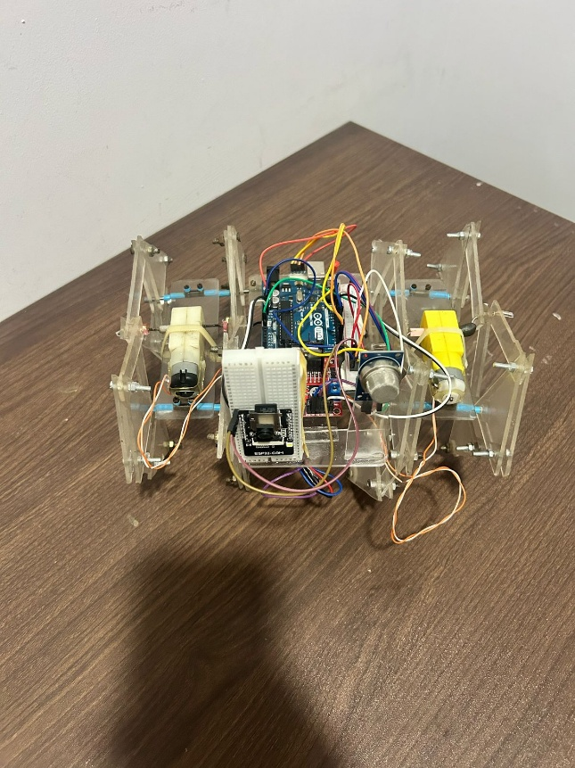
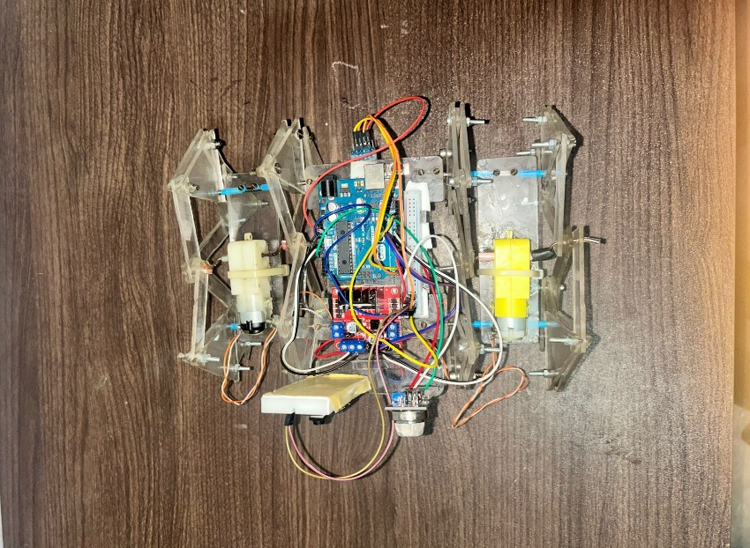
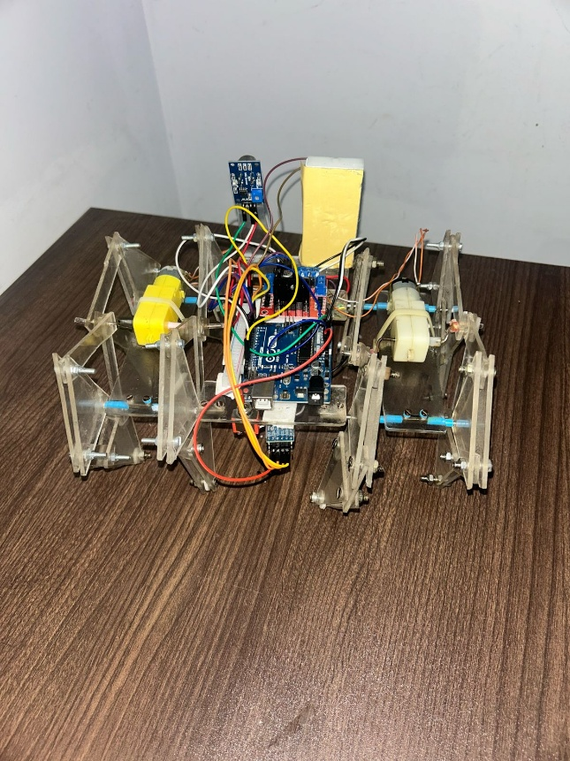
COMPLETE SETUP OF STRANDBEEST ROBOT
Front View
Top View
Back View

Slide 24
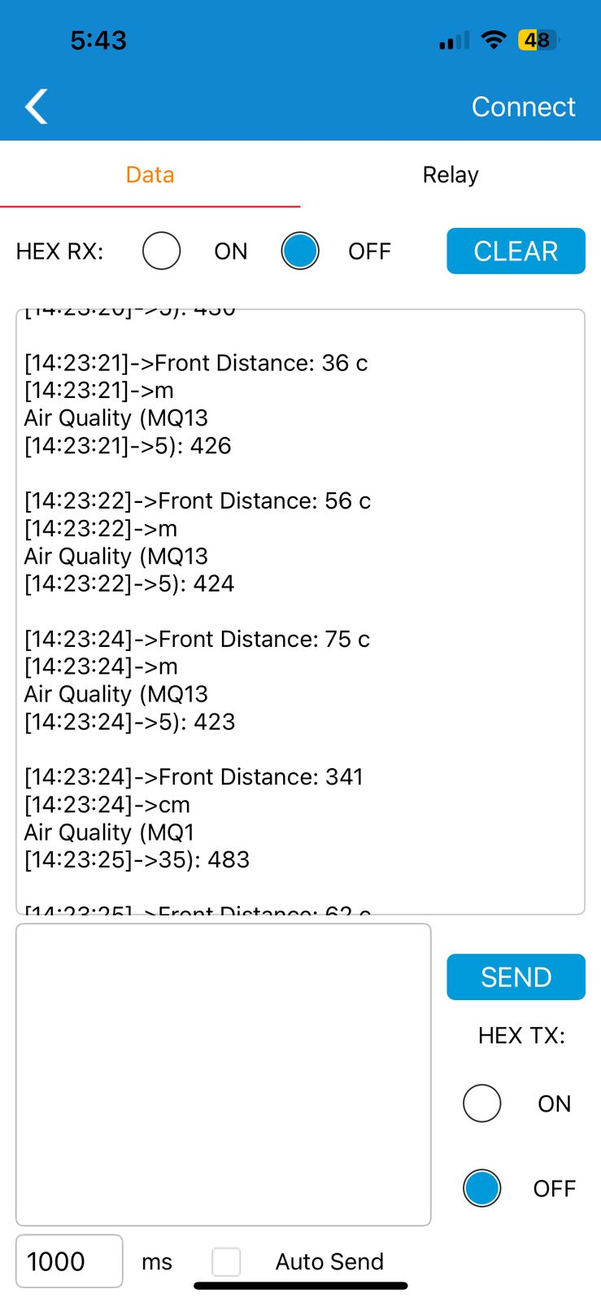
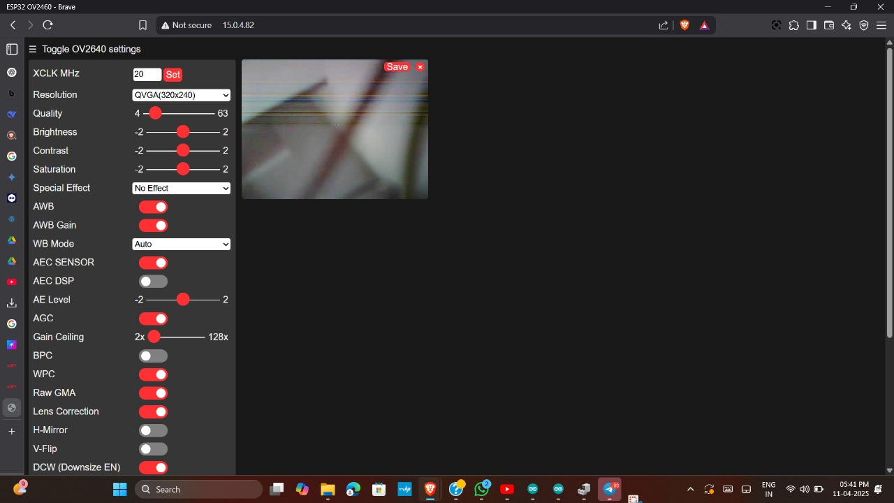
GAS DETECTION &OBJECT DETECTION RESULTS

Slide 25
CHALLENGES FACED
Marking Acrylic Sheets: Used a screwdriver for accurate marking, as the smooth surface made traditional marking tools ineffective.
Cutting the Material: Used an axe blade for clean cuts and better control to prevent cracking.
Drilling Holes: A drilling machine was used with controlled speed and pressure to avoid breakage.
Robot Assembly & Camera Mounting: Handling and arranging acrylic sheets carefully was crucial to prevent damage. Mounting the camera module was challenging due to the need for precise alignment and secure placement.

Slide 26
MONTHLY WORK PLAN
Month | Activity | Status
July | Deciding the Project idea and Studying the Project in detail | Completed
August | Finalizing and Gathering of the material and components | Completed
September | Making process of the Strandbeest robot( i.e. marking, cutting, drilling ) | Completed
October | Building the prototype of the Strandbeest robot | Completed
November | Interfacing the robot with the motors, sensors and modules | Completed
December | Working of the Strandbeest robot | Completed
January | Documentation | Completed
February | Implementation of the robot with live example | Completed
March | Submission of Project | Completed

Slide 27
CONCLUSION
The Strandbeest robot enhances the safety of coal mine workers by detecting harmful gases like Methane (CH4) and Carbon Monoxide (CO) using MQ9 gas sensors, and providing real-time alerts when gas levels become hazardous. Its Theo-Jansen linkage mechanism allows it to navigate difficult terrains, while IR sensors and a camera module enable obstacle detection and avoidance, reducing collision risks. Controlled by an ATMEGA 328P microcontroller and a Bluetooth module, the robot allows for remote monitoring and quick responses to potential dangers, ensuring the safety and efficiency of mining operations.

Slide 28
THANK YOU

